Slide 1
MATLAB
Class 3: Signal processing

Slide 2
Simulating Data
Randi() – returns random number of max i
Randn() – returns number from standard normal dist
Rand() –returns random number between 0-1
Sin() –can be used to simulate oscillatory data

Slide 3
Simulating Data
normrnd() – normal distribution
gamrnd() – gamma distribution
chi2rnd() –chi 2 distribution
rand() –uniform distribution
** note that all these distributions have many associated useful functions for stats (see class 7)

Slide 4
Data Smoothing
You can try and remove noise from your data by smoothing
Smooth() and smoothdata()
Detrend()

Slide 5
Normalizing data
Sometimes it is necessary to normalize your data before you preform an analysis
This could mean scaling the range of the data or mean centering it
Normalize()

Slide 6
Normalizing data
It is important to normalize data specially if you are comparing measures that do not have a defined range (i.e., a personality scale vs neural activity)
Normalize data if you are comparing two measures of different scales (e.g., in PCA, PLS etc)

Slide 7
Data Interpolation
If there are large outliers in your dataset, you may consider interpolation (i.e., removing outliers and guessing what the value should have been)
Filloutliers() is a useful function to identify and replace outliers in your data

Slide 8

Spectral analysis
Attempts to break down a wave or signal into its underlying frequency components
Answers the question how much of each frequency is there in my data

Slide 9
Fourier Transform
The Fast Fourier Transform is one way we can mathematically express and solve this problem.
It returns the spectrum of frequencies that make up a signal
Notes:
https://www.youtube.com/watch?v=spUNpyF58BY

Slide 10
Fourier Transform
Let us imagen we have the following timeseries: it has a sampling rate and a frequency profile
Time Domain
x = data in time / space
df = 1/fs

Slide 11
Fourier Transform
Time Domain
x = data in time / space
df = 1/fs
Frequency Domain
x = frequency
n
df = fs/n

Slide 12
Fourier Transform
Time Domain
x = data in time / space
FFT
df = 1/fs
Frequency Domain
x = frequency
n
df = fs/n

Slide 13
Fourier Transform
In MATLAB, the function fft() returns the spectral estimate of a timeseries
There are many methods of spectral decomposition, the Welch method is one often used to increase the SNR of your output.
Here your signal is broken down into smaller windows, an FFT of these windows is computed and then averaged

Slide 14
What is a Filter (no not Instagram)
A collection of methods to remove unwanted signals/artifacts/aspects of your data

Slide 15
Filtering
The smooth function (i.e., moving average, can be considered a type of filter).
Similarly, removing outliers can also act as a Low Pass filters, removing ‘spikes’ in your data
Filters come in many shapes and forms, but ultimately all aim to ‘clean’ your data…….. but there is such thing as too much of a good thing

Slide 16

Filtering

Slide 17
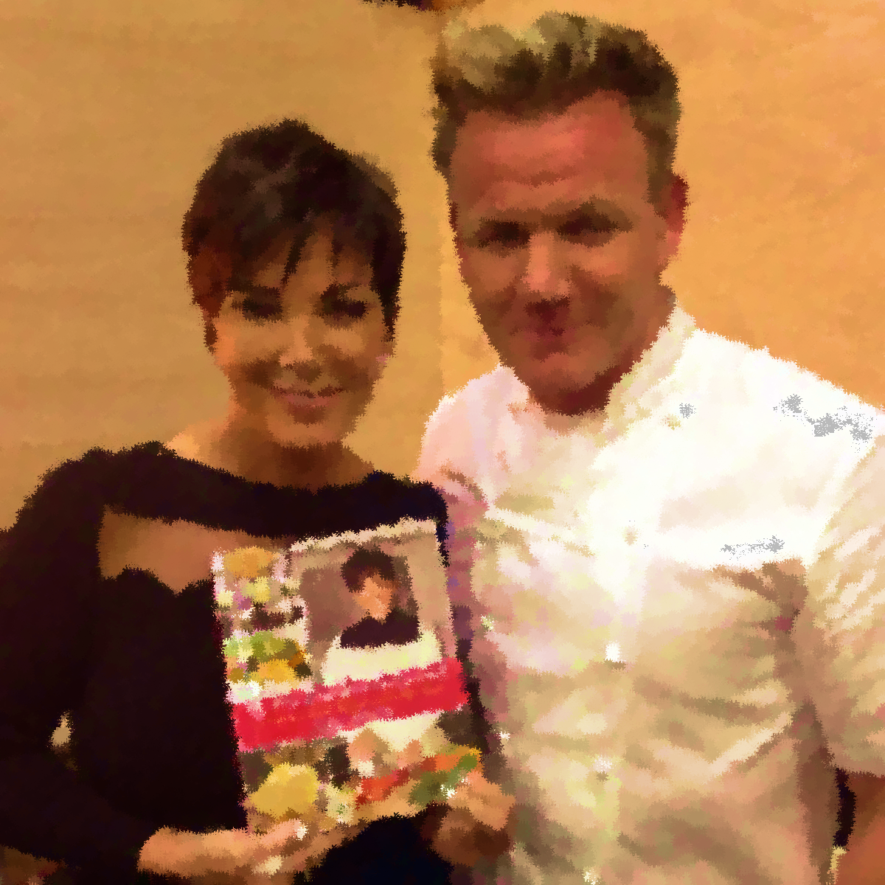
Filtering

Slide 18
Filtering
Just like on Instagram, filtering your data too much has its downsides

Slide 19
Filtering
Filters can be considered either:
Lowpass: only keeps information below the defined frequency
Highpass: only keeps the information above the defined frequency
Bandpass: only keeps the information within the defined range

Slide 20
Filtering
There are digital and analog filters, for the most part you will work with digital filters because your data is discrete (i.e., has a sampling frequency)
Infinite Impulse Response IIR are filters whose impulse response do not fall to zero (infinite series)
Finite Impulse Response FIR are filters whose impulse response are finite and will reach zero

Slide 21
Filtering
Infinite Impulse Response IIR work faster and take up less memory on a computer while executing
Finite Impulse Response FIR do not introduce nonlinear phase responses (i.e., all frequencies are shifted by the same amount in phase, creating no phase distortions)

Slide 22
Spectral analysis cont
FFT and the Welch method are not the only options for spectral analysis, we can compute changes in frequency across time.
Yet, there is an inherent tradeoff between frequency and time resolution

Slide 23
Frequency Analysis
A note on frequency analysis:
While there are many methods to compute power (e.g., FFT, morlet waves, Hilbert, etc) every measure is limited by a tradeoff between accuracy in time vs frequency
This tradeoff means that you can either be precise in your measure of frequency or time but never both

Slide 24
Frequency Analysis
This tradeoff means that you can either be precise in your measure of frequency or time but never both
For example, the Hilbert can return instantaneous power, yet is poor in frequency resolution
Whereas the Welch method has the opposite problem

Slide 25
Hilbert Transform
Transformation that takes a real timeseries and returns the analytic signal represented by the instantaneous amplitude of the time series and the phase of the oscillation
This is one way of computing spectral power over time!

Slide 26
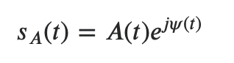
Hilbert Transform
The Hilbert transform takes the signal s(t) and tries to express it as an analytic signal composed of both real and imaginary parts

Slide 27
Hilbert Transform
In MATLAB, the function Hilbert() returns the complex number output of your signal. The real part abs(hil) reflecting the instantaneous amplitude, and the imaginary part angle(hil) being the phase of the signal

Slide 28
Find peaks
Useful function in MATLAB to find local maxima or minima in your data based on several criteria
Can modify function to use different local peak criteria
Can input descriptive statistics for reference (e.g. std)

Slide 29
Find peaks
'MinPeakDistance’ –distance between peaks
‘Npeaks’ –maximum number of peaks
‘MinPeakHeight’ –minimum height of peak
‘MinPeakProminence’ –minimum prominence of peak
‘Threshold’ –minimum difference between peak and neighbours
Etc..

Slide 30
MATLAB Toolboxes
There are many toolboxes in addition to the basic functions of MATLAB, some are developed my MATLAB and others are external and need downloading

Slide 31
MATLAB Toolboxes
Most external toolboxes can be downloaded from a website and installed either by running a command in the MATLAB terminal or by adding the toolbox to your MATLAB path

Slide 32
Example Toolboxes
SPM
EEGLAB
Brainstorm

Slide 33
Example Toolboxes
SPM
EEGLAB
Brainstorm
NOTE: not all toolboxes are compatible with one another, some may share functions with the same name. Be aware of which functions/ toolboxes are on your MATLAB path

